Slide 1

Engineering problem solving
ENGG1500
Week 2

Slide 2
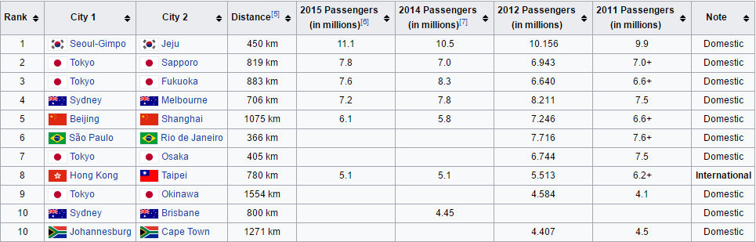
Engineering problem solving
The Sydney – Melbourne airway is the 4th busiest in the world!
We need to build a second airport

Slide 3
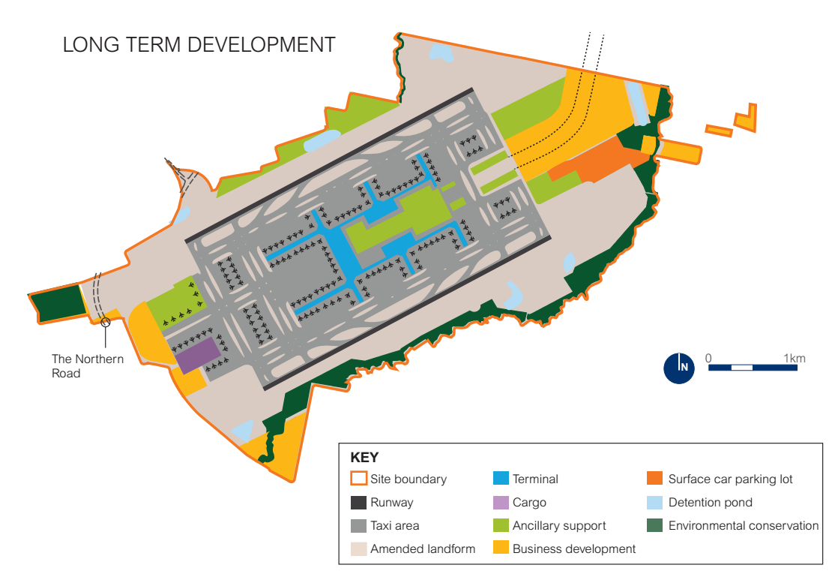
Solution
An airport for Western Sydney
Is this the correct thing to do???

Slide 4
The Engineering Method
Problem identification
Scoping the problem
Research
Potential solutions
Detailed design
Construction
Delivery
Evaluation

Slide 5
1. Problem Identification What was the actual problem?
Lots of people want to move between Sydney and Melbourne
This has nothing to do with airports!
An overcrowded airway is an effect, not a cause
Design briefs almost always start in the wrong place!
Engineers tend to be solution focused not problem focused
You need to step back and look at the real cause of the problem
Consider looking at why this is a problem

Slide 6
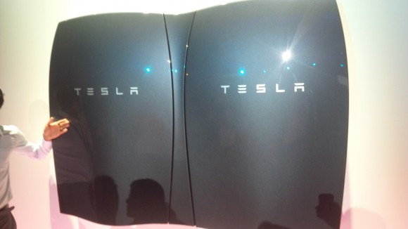

Example Problem #1
We need better batteries because current ones are too expensive to store electricity from PV panels on a large scale
The combustion of fossil fuels is not sustainable

Slide 7
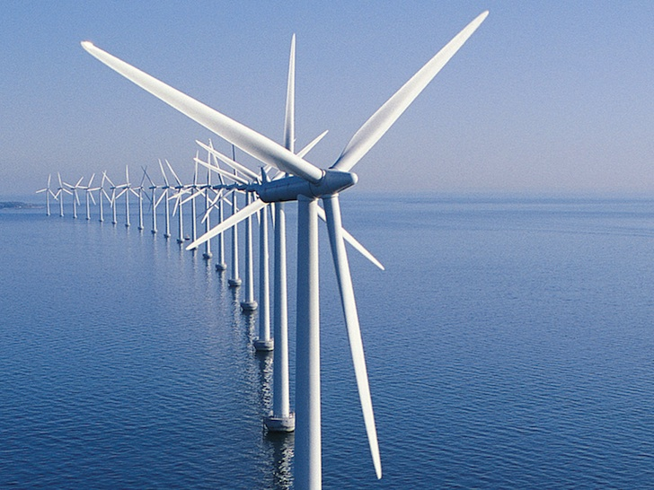
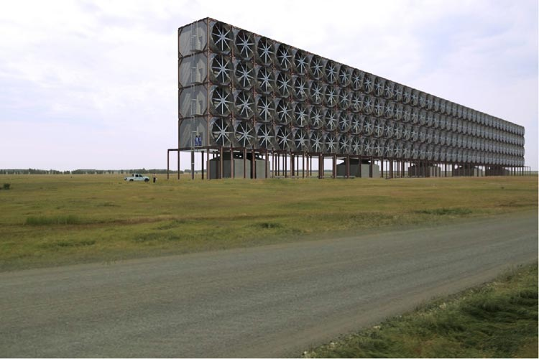

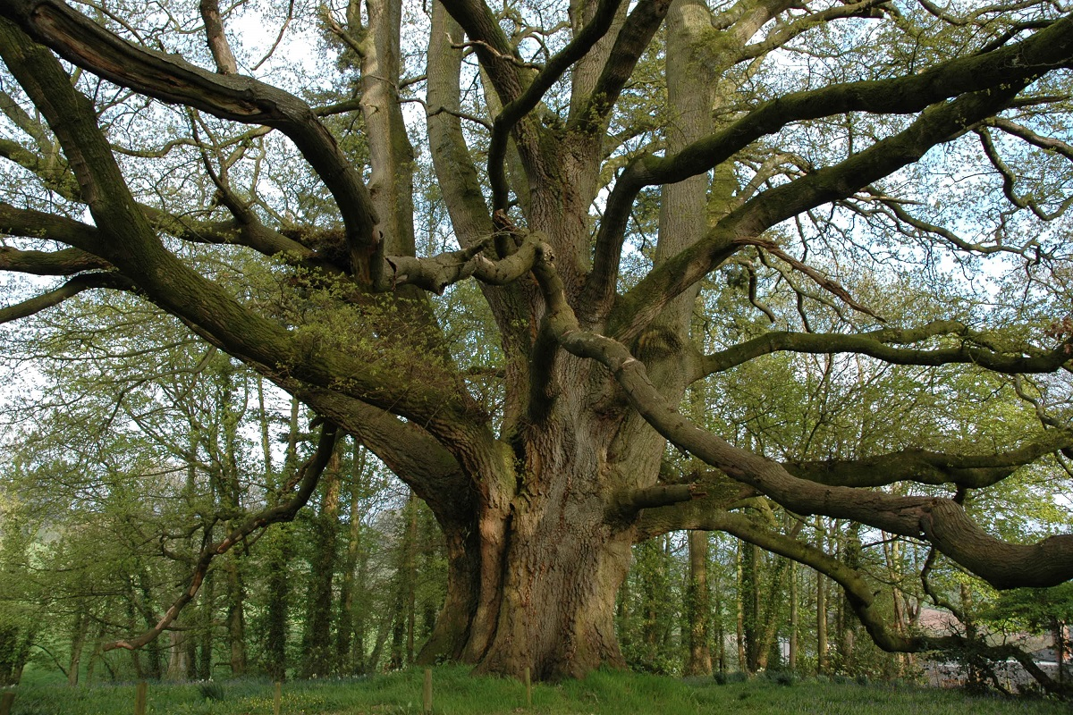
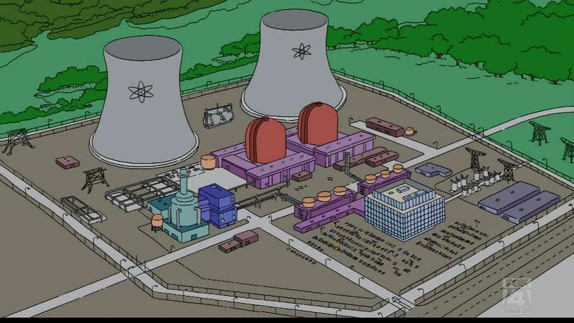
Potential solutions
Nuclear power
Diverse renewable power (Wind)
Concentrated solar and thermal storage
Carbon capture
And the list goes on and on and on
The solution space is enormous!

Slide 8
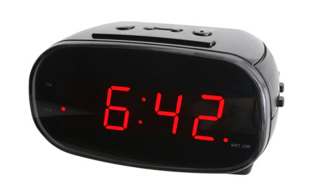
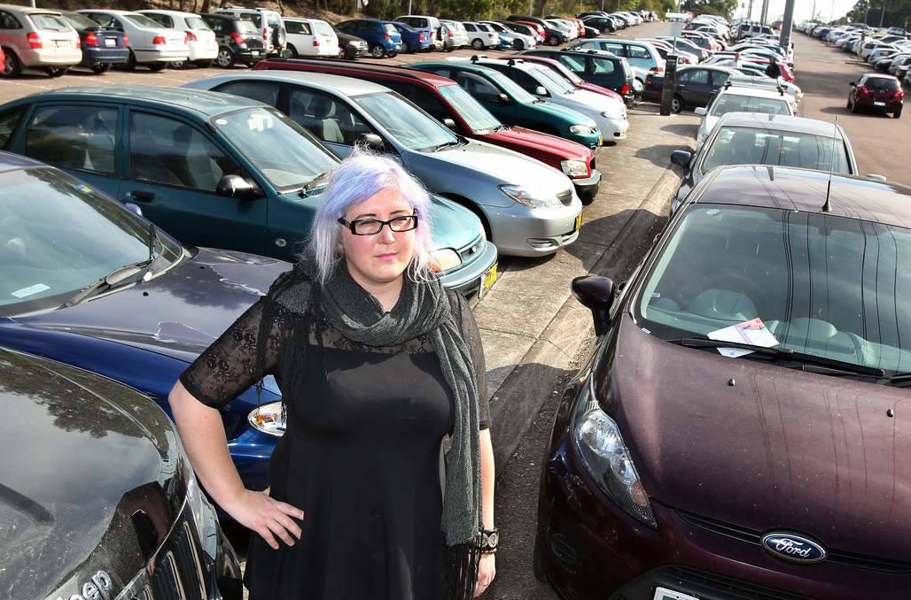
Example Problem #2
I need to start leaving earlier for Uni to find a car park
I need to get to the ENGG1500 lecture

Slide 9
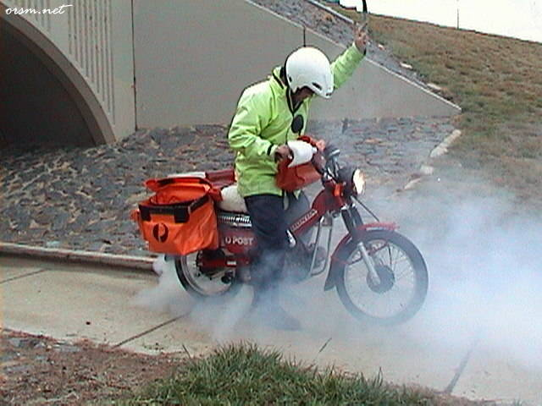
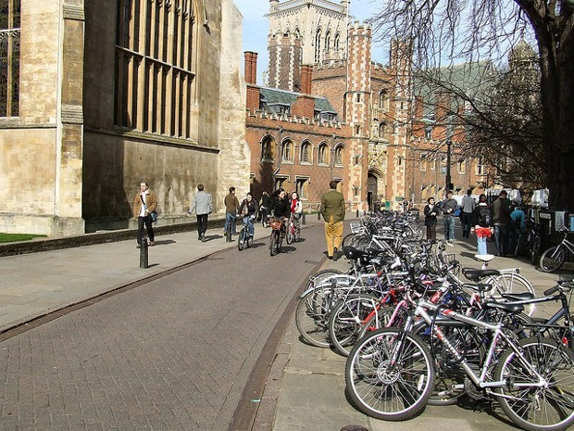
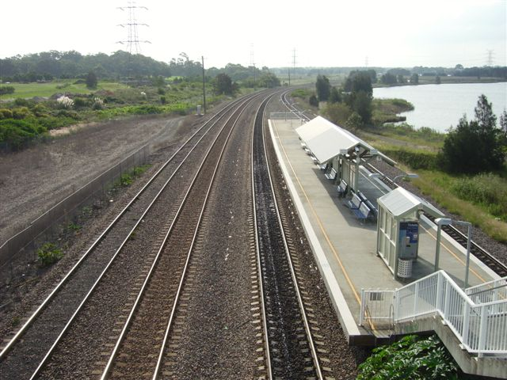
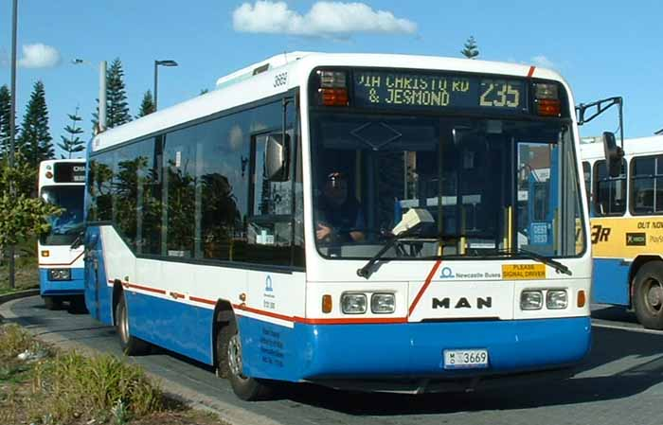
Potential solutions
Train
Bus
Bike
Walk
Carpool
Build more Parks!

Slide 10
How many steps back to take
Lots of people want to move between Sydney and Melbourne
Why do people want to move between Sydney and Melbourne?
The combustion of fossil fuels is not sustainable
What’s really wrong with climate change?
There aren't enough car spaces on campus
Why can’t you build your own?

Slide 11
2. Scoping
Defines the solution space
Comes from understanding your problem
Tells you how ‘big’ it is
Consider
Size
Capacity
Cost
Time
Usage
Anything else that is critical to performance
Some times this will be done by your client, sometimes by you
Only apply bounds at this stage

Slide 12
Scoping Examples
Lots of people want to move between Sydney and Melbourne
Number of passengers ~ 8 million people per year (>22 000 people per day)
Distance = 706 km
The combustion of fossil fuels is not sustainable
https://yearbook.enerdata.net/world-electricity-production-map-graph-and-data.html#energy-primary-production.html
Average house consumption ~16 kWh/day
You need to get to uni
Size?
Capacity?
Cost?
Time?
Usage?
Anything else that is critical to performance?

Slide 13
3. Research
Research happens in lots of different ways on drastically different scales
You need to know what’s out there
How/why things work
Don’t reinvent the wheel
You cannot solve a problem you know nothing about!

Slide 14
Research Example
Lots of people want to move between Sydney and Melbourne
Number of passengers ~ 8 million people per year (>22 000 people per day)
50-100 flights/day
Distance: 706 km point to point, 855 km drive
Time: ~1.5 hr flight, 8.5 hr drive, 11.5 hr train
Usage Cost: $49 – $809 flight, $110 fuel, $91 – $213 train ticket

Slide 15
Research Example
The combustion of fossil fuels is not sustainable
Solar irradiance ~ 1 kW/m²
Efficiency: solar panels are <15%, steam turbines ~ 40%
Average of 12 hrs sun per day, but it varies through the year
LCOE: coal ~ $100/MWh, Solar PV ~ $200/MWh

Slide 16
Research Example
You need to get to uni
Size?
Capacity?
Cost?
Time?
Usage?
Anything else that is critical to performance?

Slide 17
Research and Scoping
Go hand in hand
If you set your own scope you may redefine it as you do more research
If you wish to set a scope for someone else research will come first
Now we have defined our solution space
We have facts not opinions

Slide 18
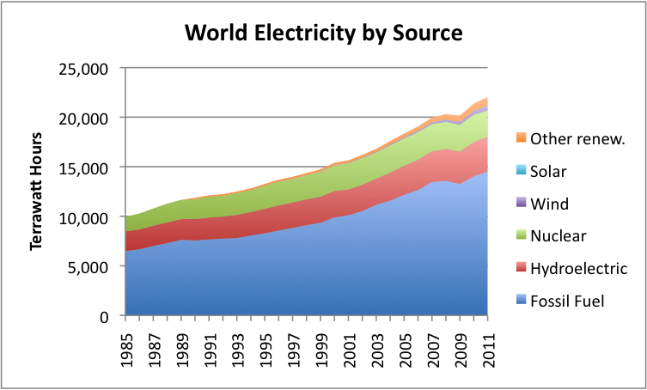
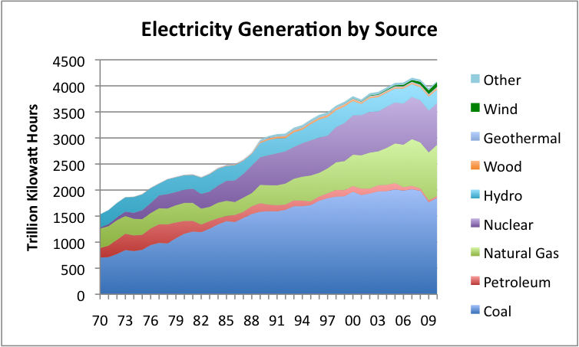
Research traps
Don’t go chasing a rabbit down a hole
Complex concepts will take a long time to research
Be careful to get multiple sources of data

Slide 19
The Engineering Method
Problem identification
Scoping the problem
Research This is where you should be at week 3 – 4
Potential solutions
Detailed design
Construction
Delivery
Evaluation

Slide 20
Potential Approaches
Ways in which the problem could be solved, not means of doing so
We jumped the gun with out other examples!
People can get between Sydney and Melbourne by:
Terrestrial transport
Aerodynamic flight
Spaceflight
Convey
Virtually
Teleportation

Slide 21
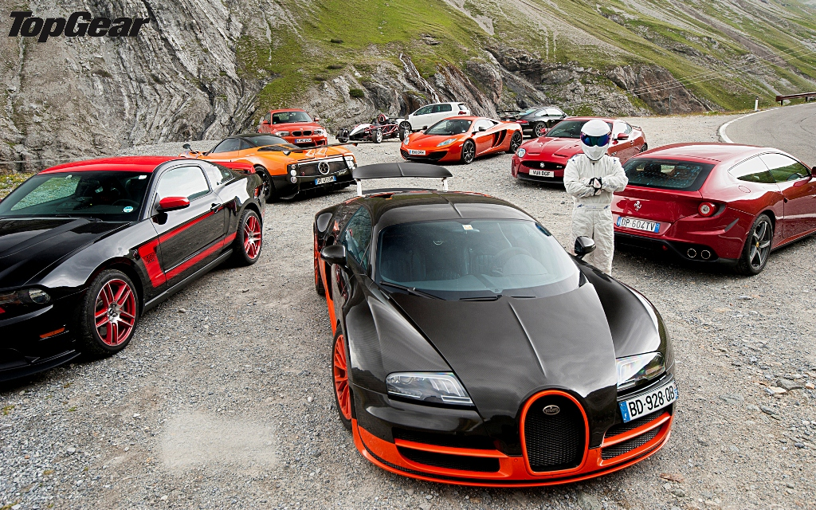
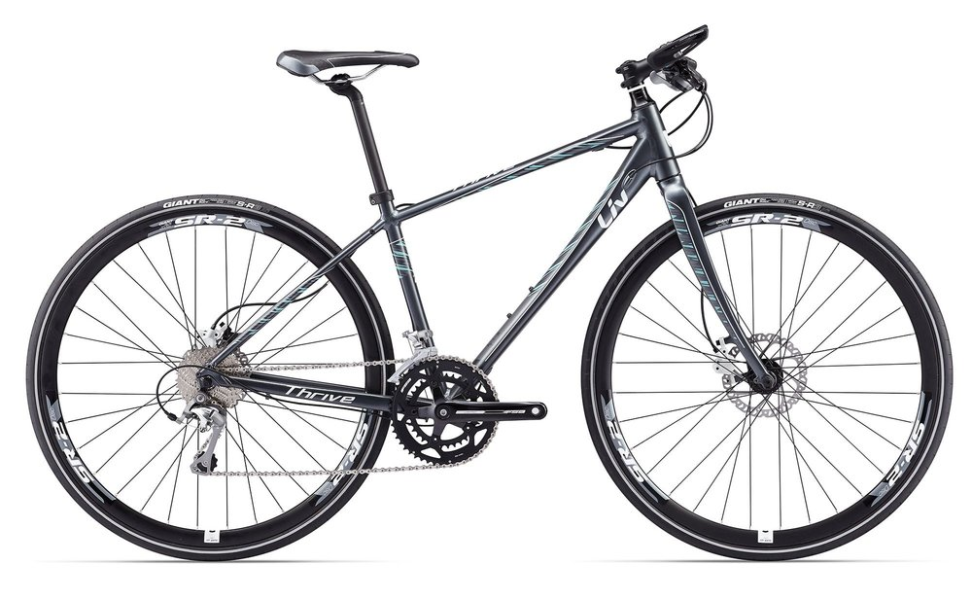
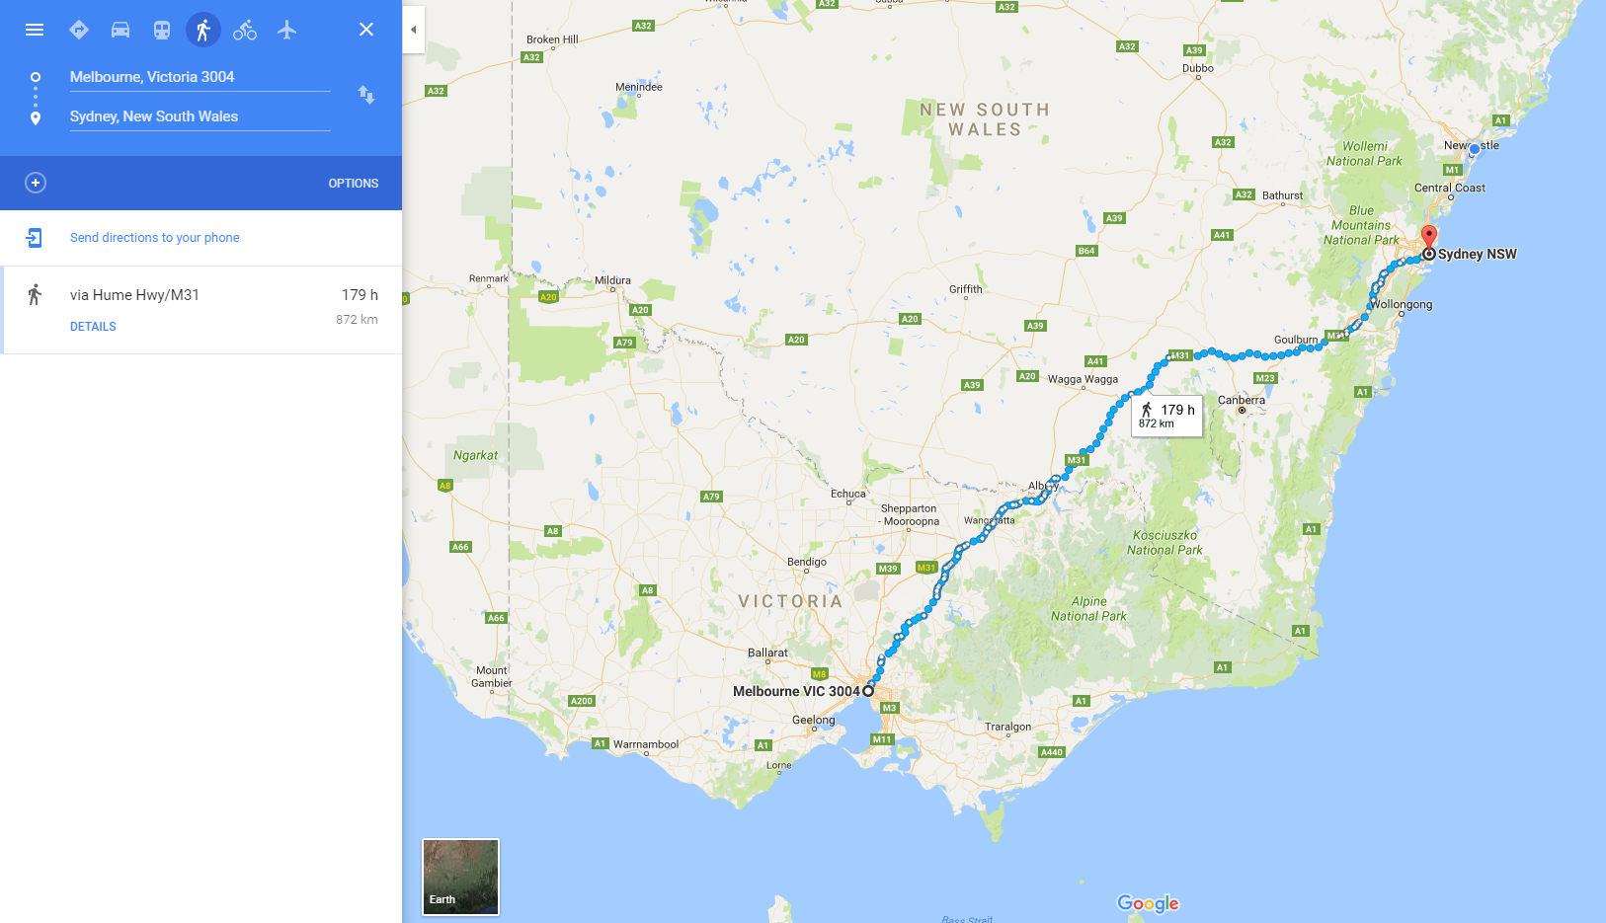
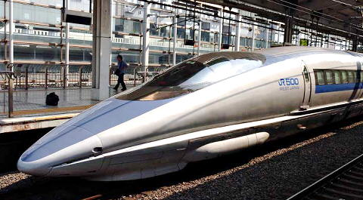
Embodiment of Approaches
Terrestrial transport
Foot
Ride
Drive
Train
Etc.

Slide 22

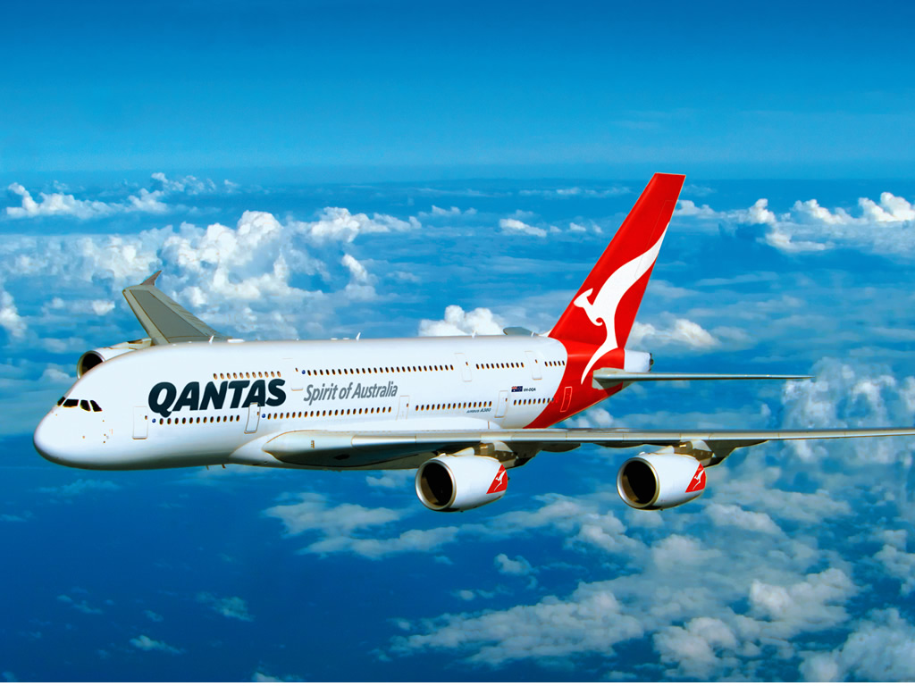
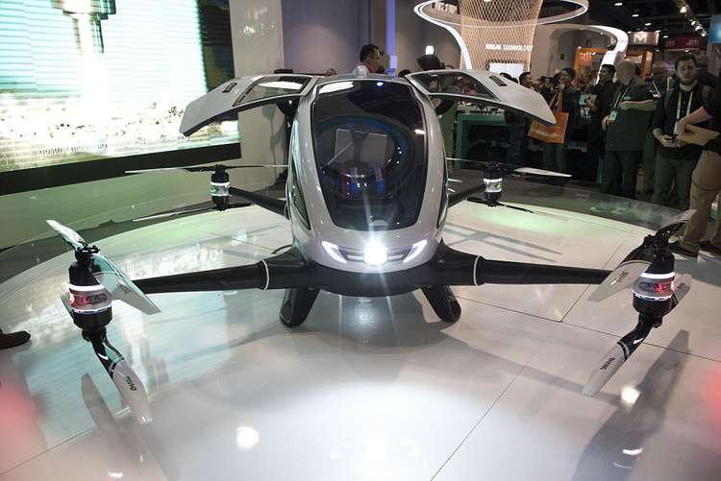
Embodiment of Approaches
Aerodynamic Flight
Plane
Helicopter
Drone

Slide 23
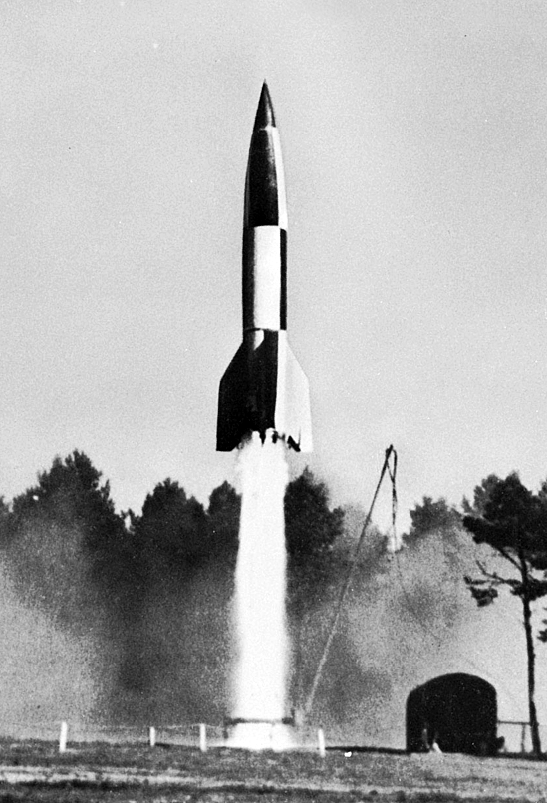
Embodiment of Approaches
Spaceflight
Sydney to Melbourne >700 km
Karman line is 100 km above earth
V2 rocket in 1944
88 km flight altitude
206 km ceiling
320 km range
1000 kg payload

Slide 24

Embodiment of Approaches
Convey
Belts

Slide 25

Embodiment of Approaches
Convey
Belts
Pneumatic
Hyperloop

Slide 26

Embodiment of Approaches
Teleportation
????

Slide 27
We are creating ideas!
Not ruling anything out
Not restrained by anything yet, we simply have a goal we are trying to achieve
Broaden out minds – research can help here
We don’t listen to anyone who says “that cant be done”
Divergent thinking
Consider how to make it worse?
Consider the verbs
Add
Subtract
Change
Etc.

Slide 28
The Engineering Method
Problem identification
Scoping the problem
Research
Potential solutions Week 5
Detailed design
Construction
Delivery
Evaluation

Slide 29
Constraints
Now we apply the wet blanket
Hard boundaries on your design
Yes or a no
Often set by external factors
Client
Minimum requirement, maximum budget, time frame
Laws of physics
Teleportation doesn’t exist… No perpetual motion devices
Many are set by your assumptions (you didn’t know you made)
The passenger has to be alive at the end of the trip
Related to Scoping

Slide 30

Performance criteria
Range of acceptable values
Generally in competition
Cost of use, speed, comfortable, effective etc.
Application dependant
Cover every important variable

Slide 31
Constraints and performance criteria
Need to be specific
Does “cost” refer to capital cost of construction or usage cost to consumer?
Need to be carful they don’t overlap
Do you need a car to be both powerful and fast?

Slide 32
What is best?
Constraints and performance criteria will allow you to rate potential designs.
Eliminate most options
More research may be required before you can make a final decision

Slide 33
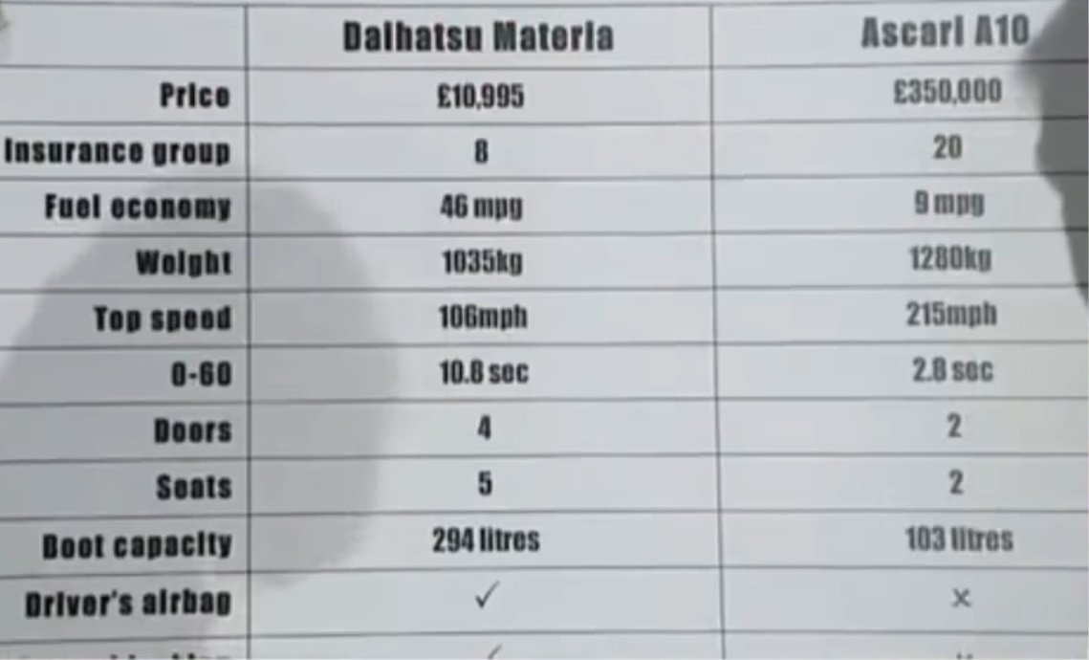

Slide 34
Criteria need to be weighted
Weighting will depend on the application
Space based vs terrestrial
Its best if these are numerical but that’s almost impossible for you to do!
This is what will separate different teams!
Most other teams will think you are wrong!

Slide 35
The process flow
Problem definition
Scoping
Research
Potential solutions
Potential approaches
Potential embodiments
Constraints
Performance criteria
Evaluation of solutions
Detailed design
Construction
Delivery
Evaluation

Slide 36
What is the ‘best’ solution
The engineering method allows you to determine what is the best solution to a problem
It is a systematic method
Works on all scales

Slide 37
Issues with the engineering method
You can make up weightings and performance criteria to make your final design look great
You need to justify your decisions based on your research
Its too long for a small project
This is more a way of thinking
Not all of the steps will make sense in every application

Slide 38
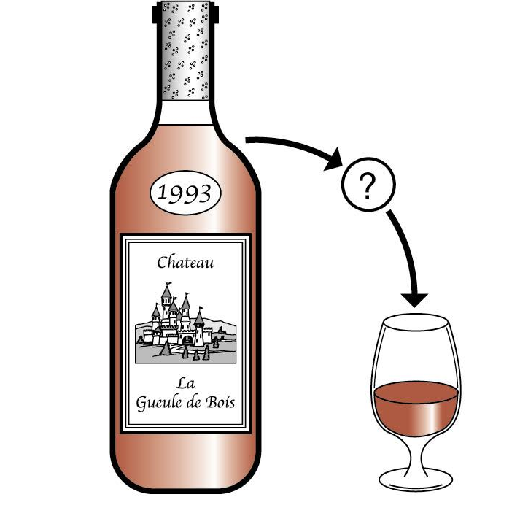
Example
Wine bottle
Obvious solution
You need a cork screw
Real problem
You need to get to the wine
Taking one too many steps back
Why are you drinking at work?

Slide 39
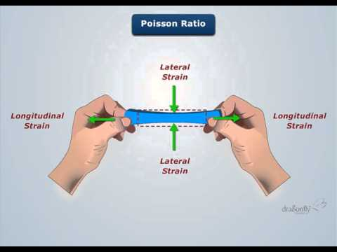
Research
Exposure to air ruins wine
Cork has a Poisson’s ratio of ~ 0, making it ideal for squeezing into/ removing from the neck of a bottle

Slide 40
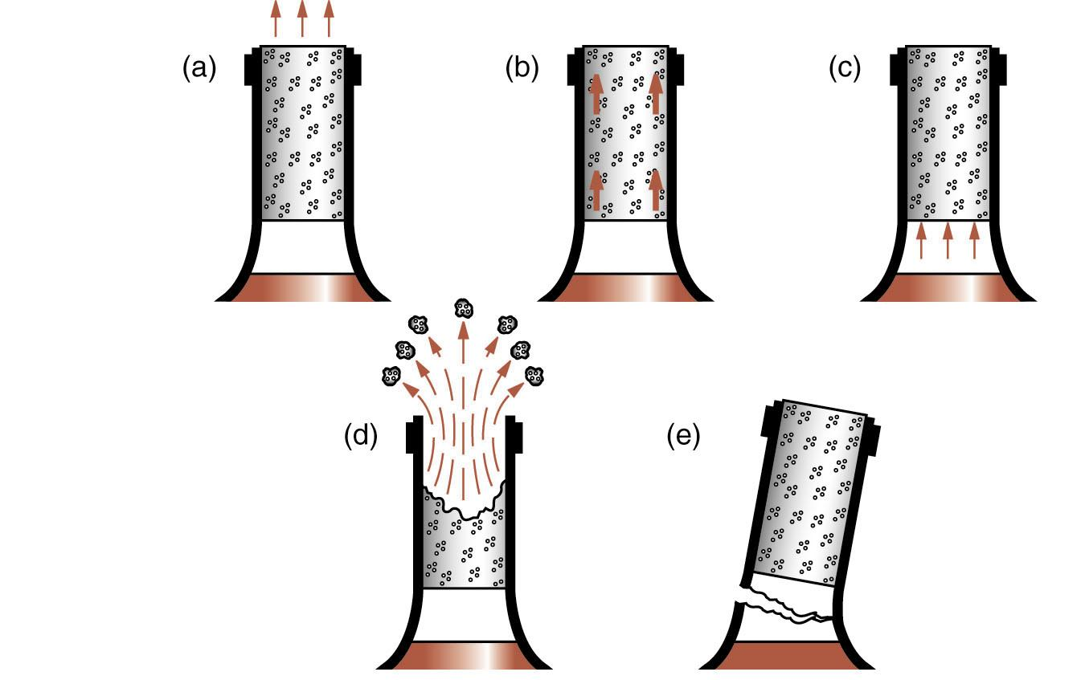
Potential approaches
Pull from the top
Shear from the sides
Force from the bottom
Destroy the cork
Negate the cork entirely

Slide 41
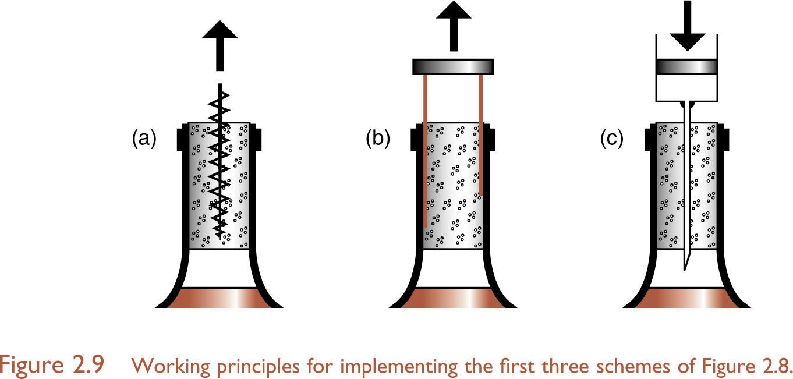
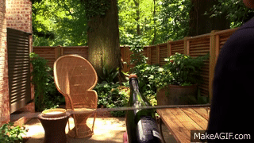
Potential embodiments
Pull the cork
Corkscrew
Shear from sides
Shear blades
Push from bottom
Pressure inducing needle
Negate the cork
Use a sword

Slide 42
Potential embodiments
Use a shoe?

Slide 43
Constraints
We cant affect the wine
Breaking the bottle may leave glass in the wine
Destroying the cork may leave cork in the wine
Need to open the bottle in less than 1 minute? Eliminate the shoe method

Slide 44
Performance criteria
Cost of product
Ease of use
Marketability

Slide 45
Best solution?
What do you think????
Why?

Slide 46
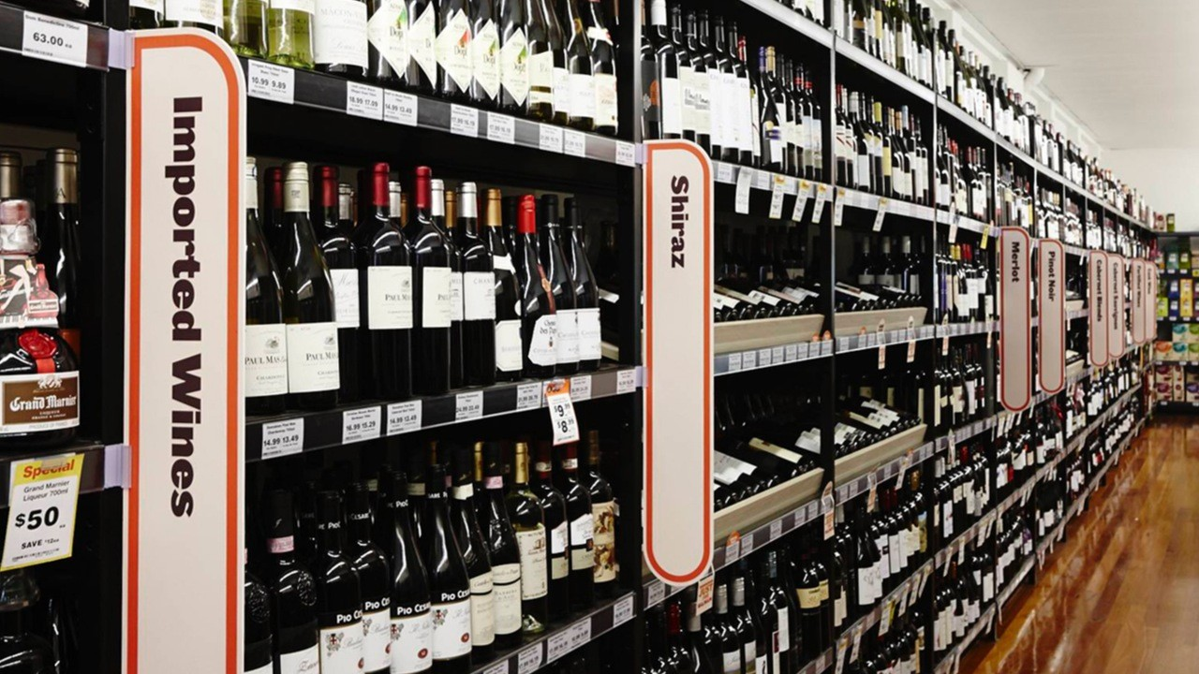
What did we miss?
Can we negate the cork without breaking the bottle?
My local bottle shop sells no wine with a cork!

Slide 47
Questions
Class timing
Assessments
Online quiz in Blackboard
Workshops
Slow start for some
Don’t worry about enrolments
Tutorials
Remember these are unstaffed
Stress less!
No textbook for this course
Textbooks are useful though

Slide 48
Feedback mechanisms at University
Student feedback on courses (SFC), every course every year
Student feedback on teaching (SFT), some courses only (ENGG1500)
Informal Feedback
Discussion board
FAQ’s
All feedback is really important for ENGG1500!

Slide 49
Tips and tricks
Only use your official university email
Other emails can end up in spam
I check the details of the sender! The Hotmail account you made when you were 12 isn’t appropriate.

Slide 50
How to research – start with information
Google it!
Wikipedia
Great place to start
I use it all the time
Don’t bet the house on it being perfect
User manuals
Tutorials
Online
Textbooks
Written for students
Generally the a great resource if you can get one
Papers
Written by/for experts in the field
Lots of assumed knowledge
Dense (hours to read a paper)
References
Useful in tracking where information came from
Question anything without them
Authority
Ease of use

Slide 51
Week 2 – What should you be doing?
Reflective learning task
On Blackboard, available until Monday this week
Start researching your project
Learning key skills
Start scoping your problem
Thinking about constraints and success criteria

Slide 52
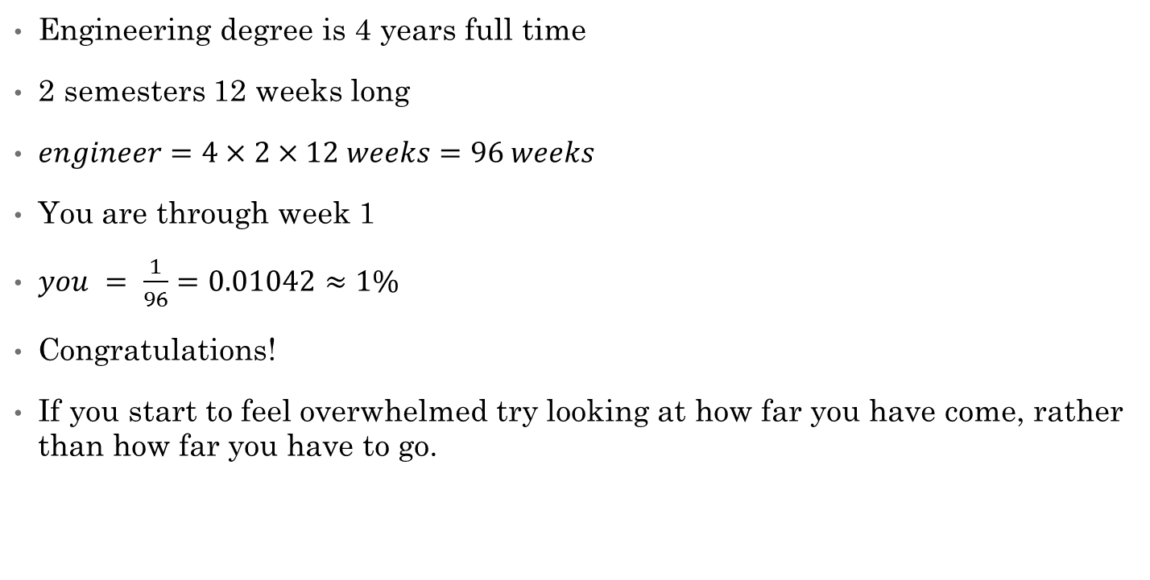
You are 1% of an engineer
Engineering degree is 4 years full time
2 semesters 12 weeks long
$engineer=4×2×12 weeks=96 weeks$
You are through week 1
$you = \frac{1}{96}=0.01042≈1\%$
Congratulations!
If you start to feel overwhelmed try looking at how far you have come, rather than how far you have to go.

